Slide 1
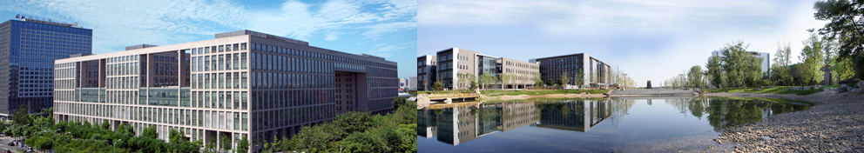
Design and Analysis of Algorithms
Part V: Dealing with Hard Problems
Lecture 14: Approximation Algorithms
Ke Xu and Yongxin Tong
(许可 与 童咏昕)
School of CSE, Beihang University

Slide 2
Outline
Introduction
Vertex-Cover Problem
Set-Cover Problem
Traveling-Salesman Problem

Slide 3
Introduction
Many important problems are NP-complete.
What can we do if we have to somehow solve them?
If input size is small, use exponential time algorithm. Identify special cases of the problems that can be solved in polynomial time.
Try general optimization methods. e.g., branch-and-bound, genetic algorithms, neural nets. Quality of solution is not guaranteed in general.
Sometimes, it is possible to find near-optimal solutions. An approximation algorithm is one that returns a near-optimal solution.
Here we discuss some examples of approximation algorithms.

Slide 4
Performance Ratios
Suppose we work on an optimization problem where each solution has an associated cost.
An approximation algorithm returns a legal solution, but the cost of that legal solution may not be optimal.
Examples:
Suppose we are looking for a minimum size vertex-cover (VC). An approximation algorithm returns a VC for us, but the size (cost) may not be minimum.
We are looking for a maximum size independent set (IS). An approximation algorithm returns an IS for us, but the size (cost) may not be maximum.
Notes:
这里可能需要首先介绍一下vertex cover和independent set，或者这里直接改成抽象的minimum problem跟maximum problem行不行？

Slide 5
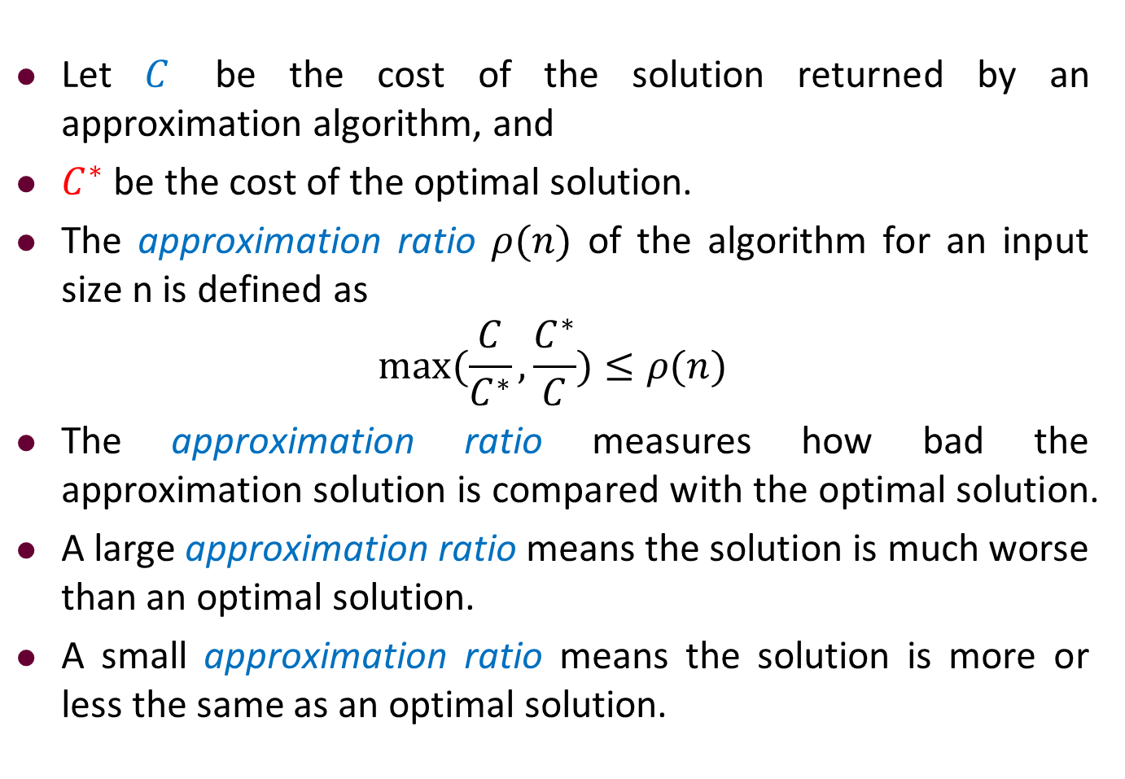
Performance Ratios
Let $C$ be the cost of the solution returned by an approximation algorithm, and
$C^{∗}$ be the cost of the optimal solution.
The approximation ratio $ρ(n)$ of the algorithm for an input size n is defined as
$$\max{(\frac{C}{C^{∗}},\frac{C^{∗}}{C})}≤ρ(n)$$
The approximation ratio measures how bad the approximation solution is compared with the optimal solution.
A large approximation ratio means the solution is much worse than an optimal solution.
A small approximation ratio means the solution is more or less the same as an optimal solution.
Notes:
这里可能需要首先介绍一下vertex cover

Slide 6
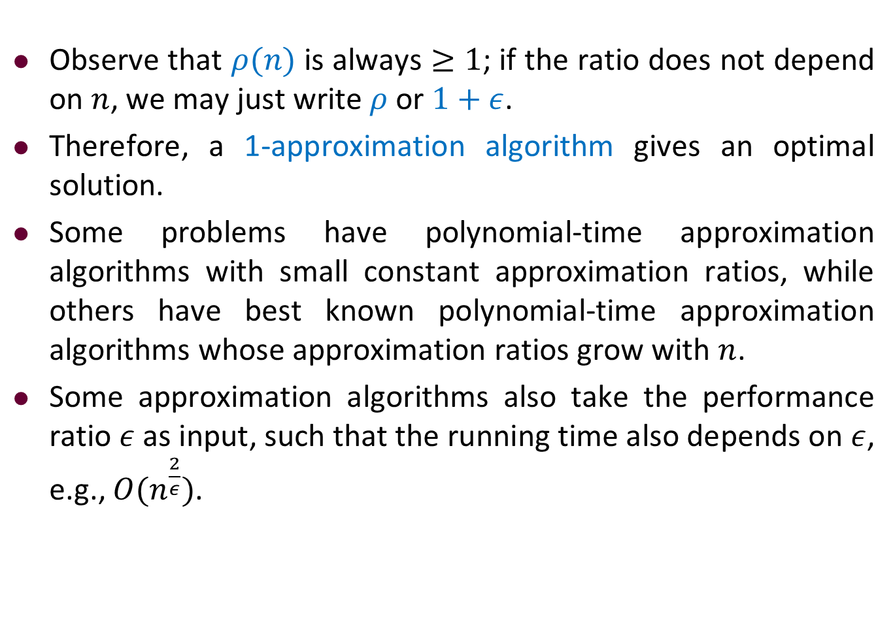
Performance Ratios
Observe that $ρ(n)$ is always $≥1$; if the ratio does not depend on $n$, we may just write $ρ$ or $1+ε$.
Therefore, a 1-approximation algorithm gives an optimal solution.
Some problems have polynomial-time approximation algorithms with small constant approximation ratios, while others have best known polynomial-time approximation algorithms whose approximation ratios grow with $n$.
Some approximation algorithms also take the performance ratio $ε$ as input, such that the running time also depends on $ε$, e.g., $O(n^{\frac{2}{ε}})$.
Notes:
这里可能需要首先介绍一下vertex cover

Slide 7
Outline
Introduction
Vertex-Cover Problem
Set-Cover Problem
Traveling-Salesman Problem

Slide 8
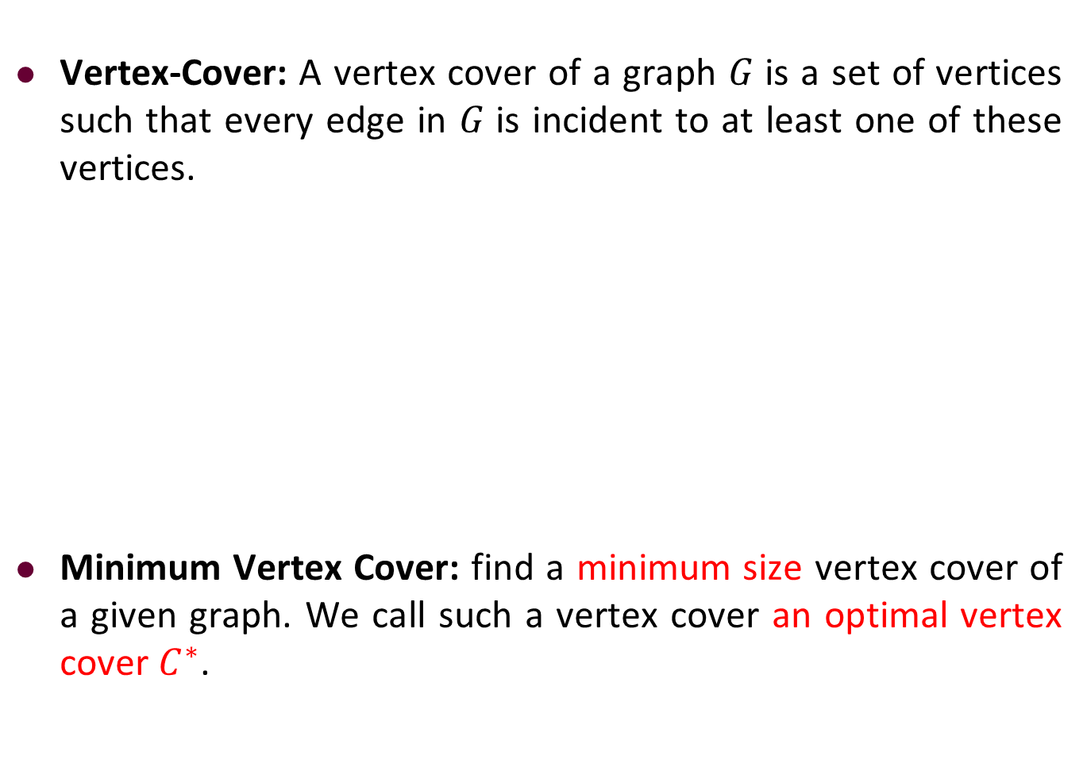
Performance Ratios
Vertex-Cover: A vertex cover of a graph 𝐺 is a set of vertices such that every edge in 𝐺 is incident to at least one of these vertices.
Minimum Vertex Cover: find a minimum size vertex cover of a given graph. We call such a vertex cover an optimal vertex cover $C^{∗}$.
b
c
d
a
e
f
g
Notes:
这里可能需要首先介绍一下vertex cover

Slide 9

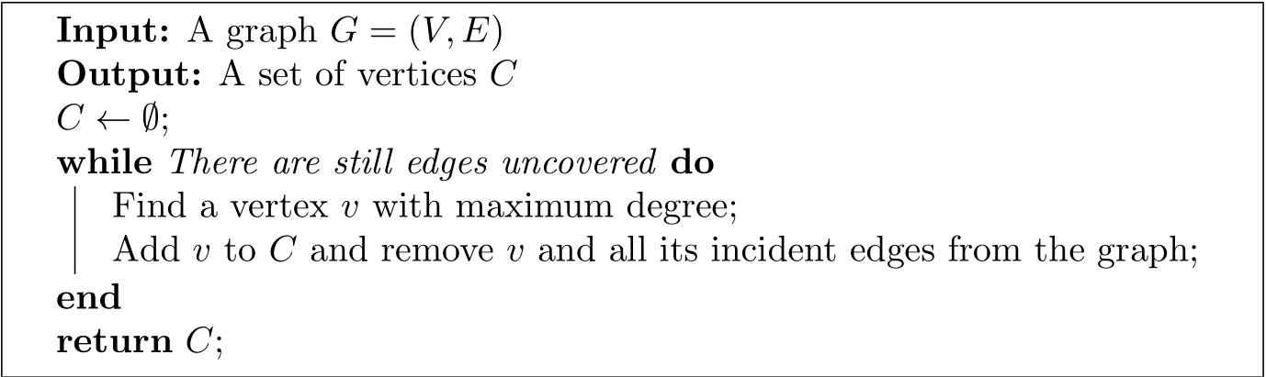
Vertex-Cover Problem: Greedy Algorithm
Idea: Keep finding a vertex which covers the maximum number of uncovered edges.
How good is this algorithm?
Notes:
这里可能需要首先介绍一下vertex cover

Slide 10
Vertex-Cover Problem: Greedy Algorithm
Idea: Keep finding a vertex which covers the maximum number of uncovered edges.
OPT = 6, all red vertices.
SOL = 11, if we are unlucky in breaking ties.
Notes:
这里可能需要首先介绍一下vertex cover

Slide 11
Vertex-Cover Problem: Greedy Algorithm
Idea: Keep finding a vertex which covers the maximum number of uncovered edges.
OPT = 6, all red vertices.
SOL = 11, if we are unlucky in breaking ties.
First we might choose all the green vertices.
Notes:
这里可能需要首先介绍一下vertex cover

Slide 12
Vertex-Cover Problem: Greedy Algorithm
Idea: Keep finding a vertex which covers the maximum number of uncovered edges.
OPT = 6, all red vertices.
SOL = 11, if we are unlucky in breaking ties.
First we might choose all the green vertices.
Then we might choose all the blue vertices.
Notes:
这里可能需要首先介绍一下vertex cover

Slide 13
Vertex-Cover Problem: Greedy Algorithm
Idea: Keep finding a vertex which covers the maximum number of uncovered edges.
OPT = 6, all red vertices.
SOL = 11, if we are unlucky in breaking ties.
First we might choose all the green vertices.
Then we might choose all the blue vertices.
And then we might choose all the orange vertices.
Notes:
这里可能需要首先介绍一下vertex cover

Slide 14
Vertex-Cover Problem: Greedy Algorithm
Idea: Keep finding a vertex which covers the maximum number of uncovered edges.
k! vertices of degree k
Generalizing
the example!
…
k!/k vertices of degree k
k!/(k-1) vertices of degree k-1
k! vertices of degree 1
Notes:
这里可能需要首先介绍一下vertex cover

Slide 15
Vertex-Cover Problem: Greedy Algorithm
Idea: Keep finding a vertex which covers the maximum number of uncovered edges.
k! vertices of degree k
Generalizing
the example!
…
k!/k vertices of degree k
k!/(k-1) vertices of degree k-1
k! vertices of degree 1
OPT = k!, all top vertices.
SOL = k! (1/k + 1/(k-1) + 1/(k-2) + … + 1) ≈ k! log(k), all bottom vertices.
Notes:
这里可能需要首先介绍一下vertex cover

Slide 16
Vertex-Cover Problem: Greedy Algorithm
Idea: Keep finding a vertex which covers the maximum number of uncovered edges.
Approximation ratio = log(k)
Not a constant factor
approximation algorithm!
k! vertices of degree k
Generalizing
the example!
…
k!/k vertices of degree k
k!/(k-1) vertices of degree k-1
k! vertices of degree 1
OPT = k!, all top vertices.
SOL = k! (1/k + 1/(k-1) + 1/(k-2) + … + 1) ≈ k! log(k), all bottom vertices.
Notes:
这里可能需要首先介绍一下vertex cover

Slide 17
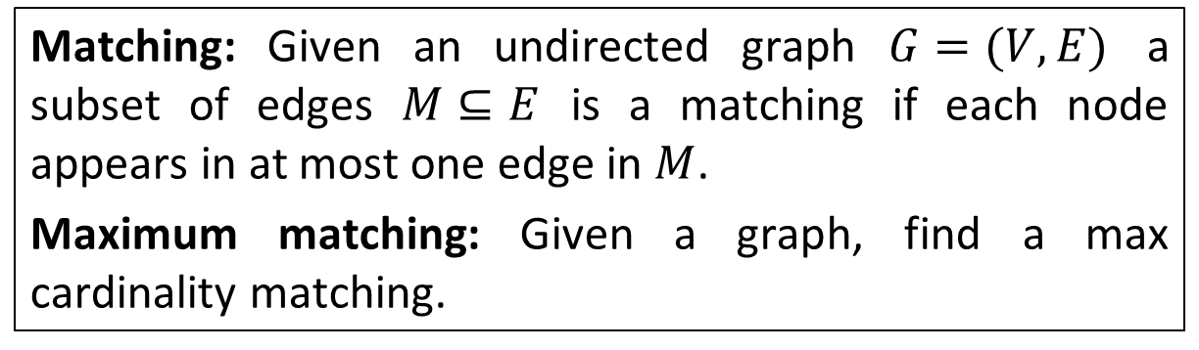
Vertex-Cover Problem
In bipartite graphs, maximum matching = minimum vertex cover.
In general graphs, this is not true.
How large can this gap be?
Matching: Given an undirected graph $G=(V,E)$ a subset of edges $M⊆E$ is a matching if each node appears in at most one edge in $M$.
Maximum matching: Given a graph, find a max cardinality matching.
Notes:
这里可能需要首先介绍一下vertex cover

Slide 18
Vertex-Cover Problem
Fix a maximum matching. Call the vertices involved black.
Since the matching is maximum, every edge must have a black endpoint.
So, by choosing all the black vertices, we have a vertex cover.
SOL <= 2 * size of a maximum matching
Notes:
这里可能需要首先介绍一下vertex cover

Slide 19
Vertex-Cover Problem
What about an optimal solution?
Each edge in the matching has to be covered by a different vertex!
OPT >= size of a maximum matching
So, OPT <= 2 SOL, and we have a 2-approximation algorithm!
Notes:
这里可能需要首先介绍一下vertex cover

Slide 20
Vertex-Cover Problem: Example
b
c
d
a
e
f
g
(1)
Notes:
这里可能需要首先介绍一下vertex cover

Slide 21
Vertex-Cover Problem: Example
b
c
d
b
c
d
a
e
f
g
a
e
f
g
(1)
(2)
Notes:
这里可能需要首先介绍一下vertex cover

Slide 22
Vertex-Cover Problem: Example
b
c
d
b
c
d
a
e
f
g
a
e
f
g
(1)
(2)
b
c
d
a
e
f
g
(3)
Notes:
这里可能需要首先介绍一下vertex cover

Slide 23
Vertex-Cover Problem: Example
b
c
d
b
c
d
a
e
f
g
a
e
f
g
(1)
(2)
b
c
d
b
c
d
a
e
f
g
a
e
f
g
(3)
(4)
Notes:
这里可能需要首先介绍一下vertex cover

Slide 24

Vertex-Cover Problem: Example
b
c
d
b
c
d
a
e
f
g
a
e
f
g
(1)
(2)
b
c
d
b
c
d
a
e
f
g
a
e
f
g
(3)
(4)
$$VC=\{b,c,d,e,f,g\}$$
Notes:
这里可能需要首先介绍一下vertex cover

Slide 25
Vertex-Cover Problem: Approximation Ratio
Approximate min-max theorem:
Maximum matching
<= minimum vertex cover
<= 2*Maximum matching
Major open question: Can we obtain a 1.99-approximation algorithm?
Notes:
这里可能需要首先介绍一下vertex cover

Slide 26
Outline
Introduction
Vertex-Cover Problem
Set-Cover Problem
Traveling-Salesman Problem

Slide 27

Set-Cover Problem
Set-Cover Problem: Given a ground set $U$ of $n$ elements, a collection of subsets of $U$, $S^{∗}=\{S_{1},S_{2},…,S_{k}\}$, where each subset has a cost $c(S_{i})$, find a minimum cost subcollection of $S^{∗}$ that covers all elements of $U$.
Vertex cover is a special case, why?
A convenient interpretation:
sets
elements
Choose a min-cost set of white vertices to “cover” all black vertices.
Notes:
P19

Slide 28
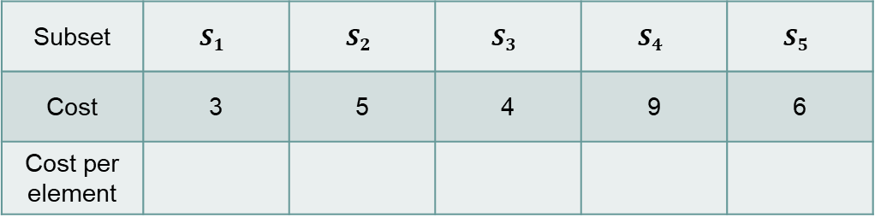





Set-Cover Problem： Example
Idea:
Keep finding a set which is the most effective in covering remaining elements.
$$S_{1}$$
$$S_{2}$$
$$S_{3}$$
$$S_{4}$$
$$S_{5}$$
sets
elements
Subset | $$S_{1}$$ | $$S_{2}$$ | $$S_{3}$$ | $$S_{4}$$ | $$S_{5}$$
Cost | 3 | 5 | 4 | 9 | 6
Cost per element
Notes:
P19

Slide 29
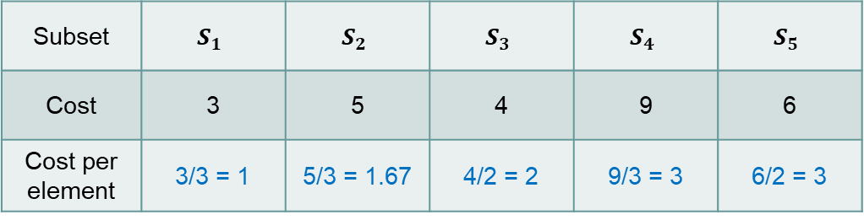
Set-Cover Problem： Example
Idea:
Keep finding a set which is the most effective in covering remaining elements.
$$S_{1}$$
$$S_{2}$$
$$S_{3}$$
$$S_{4}$$
$$S_{5}$$
sets
elements
Subset | $$S_{1}$$ | $$S_{2}$$ | $$S_{3}$$ | $$S_{4}$$ | $$S_{5}$$
Cost | 3 | 5 | 4 | 9 | 6
Cost per element | 3/3 = 1 | 5/3 = 1.67 | 4/2 = 2 | 9/3 = 3 | 6/2 = 3
Notes:
P19

Slide 30

Set-Cover Problem： Example
Idea:
Keep finding a set which is the most effective in covering remaining elements.
$$S_{1}$$
$$S_{2}$$
$$S_{3}$$
$$S_{4}$$
$$S_{5}$$
sets
elements
Subset | $$S_{1}$$ | $$S_{2}$$ | $$S_{3}$$ | $$S_{4}$$ | $$S_{5}$$
Cost | 3 | 5 | 4 | 9 | 6
Cost per element | 3/3 = 1 | 5/3 = 1.67 | 4/2 = 2 | 9/3 = 3 | 6/2 = 3
$$R=\{S_{1}\}$$
Notes:
P19

Slide 31
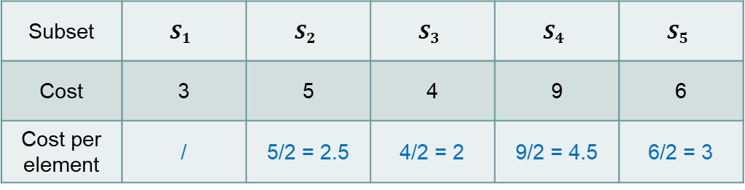

Set-Cover Problem： Example
Idea:
Keep finding a set which is the most effective in covering remaining elements.
$$S_{1}$$
$$S_{2}$$
$$S_{3}$$
$$S_{4}$$
$$S_{5}$$
sets
elements
Subset | $$S_{1}$$ | $$S_{2}$$ | $$S_{3}$$ | $$S_{4}$$ | $$S_{5}$$
Cost | 3 | 5 | 4 | 9 | 6
Cost per element | / | 5/2 = 2.5 | 4/2 = 2 | 9/2 = 4.5 | 6/2 = 3
$$R=\{S_{1}\}$$
Notes:
P19

Slide 32

Set-Cover Problem： Example
Idea:
Keep finding a set which is the most effective in covering remaining elements.
$$S_{1}$$
$$S_{2}$$
$$S_{3}$$
$$S_{4}$$
$$S_{5}$$
sets
elements
Subset | $$S_{1}$$ | $$S_{2}$$ | $$S_{3}$$ | $$S_{4}$$ | $$S_{5}$$
Cost | 3 | 5 | 4 | 9 | 6
Cost per element | / | 5/2 = 2.5 | 4/2 = 2 | 9/2 = 4.5 | 6/2 = 3
$$R=\{S_{1},S_{3}\}$$
Notes:
P19

Slide 33
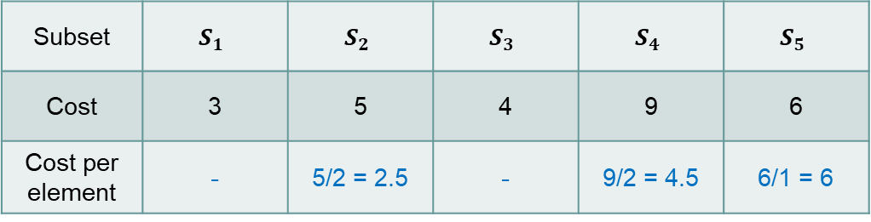

Set-Cover Problem： Example
Idea:
Keep finding a set which is the most effective in covering remaining elements.
$$S_{1}$$
$$S_{2}$$
$$S_{3}$$
$$S_{4}$$
$$S_{5}$$
sets
elements
Subset | $$S_{1}$$ | $$S_{2}$$ | $$S_{3}$$ | $$S_{4}$$ | $$S_{5}$$
Cost | 3 | 5 | 4 | 9 | 6
Cost per element | - | 5/2 = 2.5 | - | 9/2 = 4.5 | 6/1 = 6
$$R=\{S_{1},S_{3}\}$$
Notes:
P19

Slide 34
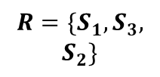
Set-Cover Problem： Example
Idea:
Keep finding a set which is the most effective in covering remaining elements.
$$S_{1}$$
$$S_{2}$$
$$S_{3}$$
$$S_{4}$$
$$S_{5}$$
sets
elements
Subset | $$S_{1}$$ | $$S_{2}$$ | $$S_{3}$$ | $$S_{4}$$ | $$S_{5}$$
Cost | 3 | 5 | 4 | 9 | 6
Cost per element | - | 5/2 = 2.5 | - | 9/2 = 4.5 | 6/1 = 6
$$R=\{S_{1},S_{3},$$
$$S_{2}\}$$
Notes:
P19

Slide 35
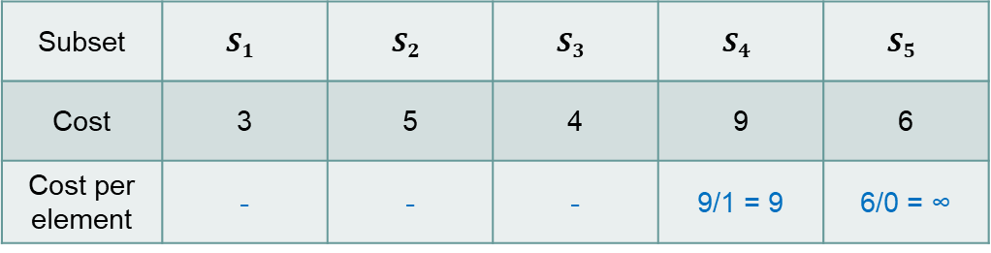

Set-Cover Problem： Example
Idea:
Keep finding a set which is the most effective in covering remaining elements.
$$S_{1}$$
$$S_{2}$$
$$S_{3}$$
$$S_{4}$$
$$S_{5}$$
sets
elements
Subset | $$S_{1}$$ | $$S_{2}$$ | $$S_{3}$$ | $$S_{4}$$ | $$S_{5}$$
Cost | 3 | 5 | 4 | 9 | 6
Cost per element | - | - | - | 9/1 = 9 | 6/0 = ∞
$$R=\{S_{1},S_{3},$$
$$S_{2}\}$$
Notes:
P19

Slide 36
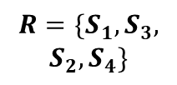
Set-Cover Problem： Example
Idea:
Keep finding a set which is the most effective in covering remaining elements.
$$S_{1}$$
$$S_{2}$$
$$S_{3}$$
$$S_{4}$$
$$S_{5}$$
sets
elements
Subset | $$S_{1}$$ | $$S_{2}$$ | $$S_{3}$$ | $$S_{4}$$ | $$S_{5}$$
Cost | 3 | 5 | 4 | 9 | 6
Cost per element | - | - | - | 9/1 = 9 | 6/0 = ∞
$$R=\{S_{1},S_{3},$$
$$S_{2},S_{4}\}$$
Notes:
P19

Slide 37

Set-Cover Problem： Example
Idea:
Keep finding a set which is the most effective in covering remaining elements.
$$S_{1}$$
$$S_{2}$$
$$S_{3}$$
$$S_{4}$$
$$S_{5}$$
sets
elements
Subset | $$S_{1}$$ | $$S_{2}$$ | $$S_{3}$$ | $$S_{4}$$ | $$S_{5}$$
Cost | 3 | 5 | 4 | 9 | 6
Cost per element | - | - | - | 9/1 = 9 | 6/0 = ∞
$$R=\{S_{1},S_{3},$$
$$S_{2},S_{4}\}$$
Notes:
P19

Slide 38
Set-Cover Problem: Approximation Ratio
Approximation Ratio = log n
Major open question: Whether the greedy algorithm has the best
and tightest approximation ratio?
Notes:
这里可能需要首先介绍一下vertex cover

Slide 39
Outline
Introduction
Vertex-Cover Problem
Set-Cover Problem
Traveling-Salesman Problem

Slide 40
Traveling-Salesman Problem
Hamiltonian Path Problem: Given an undirected graph, find a cycle visiting every vertex exactly once.
Eulerian Path Problem: Given an undirected graph, find a walk visiting every edge exactly once. Notice that in a walk some vertices may have been visited more than once.
Notes:
这里可能需要首先介绍一下vertex cover

Slide 41
Traveling-Salesman Problem
Hamiltonian Path Problem: Given an undirected graph, find a cycle visiting every vertex exactly once.
Eulerian Path Problem: Given an undirected graph, find a walk visiting every edge exactly once. Notice that in a walk some vertices may have been visited more than once.
NP-complete
polynomial time solvable.
A graph has an Eulerian path if and
only if every vertex has an even degree.
Notes:
这里可能需要首先介绍一下vertex cover

Slide 42
Traveling-Salesman Problem
Traveling Salesman Problem (TSP): Given a complete graph with nonnegative edge costs, find a minimum cost cycle visiting every vertex exactly once.
Application: Given a number of cities and the costs of traveling from any city to any other city, what is the cheapest round-trip route that visits each city exactly once and then returns to the starting city?
One of the most well-studied problem in combinatorial optimization.
Notes:
这里可能需要首先介绍一下vertex cover

Slide 43
Traveling-Salesman Problem
Traveling Salesman Problem (TSP): Given a complete graph with nonnegative edge costs, find a minimum cost cycle visiting every vertex exactly once.
Hamiltonian Path Problem: Given an undirected graph, find a cycle visiting every vertex exactly once.
The Hamiltonian path problem is a special
case of the Traveling Salesman Problem.
For each edge, we add an edge of cost 1.
For each non-edge, we add an edge of cost 2.
If there is a Hamiltonian path, then there is a cycle of cost n.
If there is no Hamiltonian path, then every cycle has cost at least n+1.
Notes:
这里可能需要首先介绍一下vertex cover

Slide 44
Traveling-Salesman Problem
Theorem: There is no constant factor approximation algorithm for TSP, unless P=NP.
Idea: Use the Hamiltonian path problem.
For each edge, we add an edge of cost 1.
For each non-edge, we add an edge of cost nk.
If there is a Hamiltonian path, then there is a cycle of cost n.
If there is no Hamiltonian path, then every cycle has cost greater than nk.
So, if you have a k-approximation algorithm for TSP,
one just needs to check if the returned solution is at most nk.
If yes, then the original graph has a Hamiltonian path.
Otherwise, the original graph has no Hamiltonian path.
Notes:
这里可能需要首先介绍一下vertex cover

Slide 45
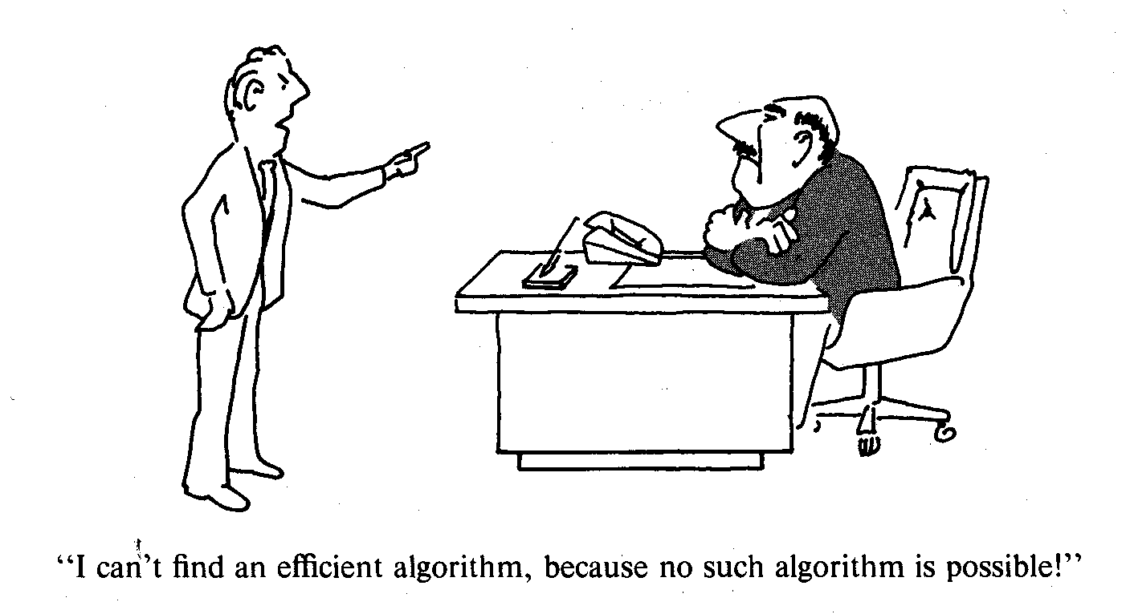
Traveling-Salesman Problem
Observation: in real world situation, the costs satisfy triangle inequality.
There is no constant factor approximation algorithm for TSP, what can we do then?
a
a + b ≥ c
c
For example, think of cost of an edge
as the distance between two points.
b
Notes:
这里可能需要首先介绍一下vertex cover

Slide 46
Traveling-Salesman Problem
Metric Traveling Salesman Problem (metric TSP): Given a complete graph with edge costs satisfying triangle inequalities, find a minimum cost cycle visiting every vertex exactly once.
1
First check the bad example.
nk
This violates triangle inequality!
1
How could triangle inequalities help in finding approximation algorithm?
Notes:
这里可能需要首先介绍一下vertex cover

Slide 47
Traveling-Salesman Problem
What can be a good lower bound to the cost of TSP?
A tour contains a matching.
Let OPT be the cost of an optimal tour, since a tour contains two matchings,
the cost of a minimum weight perfect matching is at most OPT/2.
A tour contains a spanning tree.
So, the cost of a minimum spanning tree is at most OPT.
Notes:
这里可能需要首先介绍一下vertex cover

Slide 48
Traveling-Salesman Problem
How to formalize the idea of “following” a minimum spanning tree?
Notes:
这里可能需要首先介绍一下vertex cover

Slide 49
Traveling-Salesman Problem
How to formalize the idea of “following” a minimum spanning tree?
Key idea: double all the edges and find an Eulerian tour.
Notes:
这里可能需要首先介绍一下vertex cover

Slide 50
Traveling-Salesman Problem
How to formalize the idea of “following” a minimum spanning tree?
Key idea: double all the edges and find an Eulerian tour.
This graph has cost 2MST.
Notes:
这里可能需要首先介绍一下vertex cover

Slide 51
Traveling-Salesman Problem
Strategy: shortcut this Eulerian tour.
Key idea: double all the edges and find an Eulerian tour.
This graph has cost 2MST.
Notes:
这里可能需要首先介绍一下vertex cover

Slide 52
Traveling-Salesman Problem
By triangle inequalites, the shortcut tour is not longer than the Eulerian tour.
Each vertex can only be used exactly once in the shortcut tour.
Notes:
这里可能需要首先介绍一下vertex cover

Slide 53

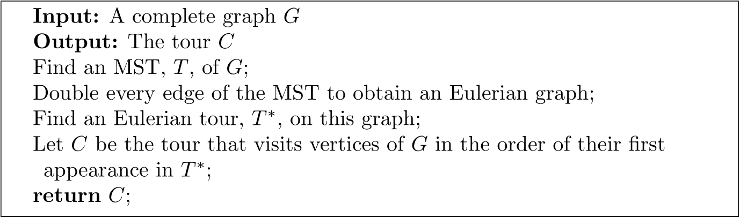
Traveling-Salesman Problem
Analysis:
cost(T) ≤ OPT (because MST is a lower bound of TSP)
cost(T*) = 2cost(T) (because every edge appears twice)
cost(C) ≤ cost(T*) (because of triangle inequalities, shortcutting)
So, cost(C) ≤ 2OPT
Notes:
这里可能需要首先介绍一下vertex cover

Slide 54
Traveling-Salesman Problem
There is a 1.5 approximation algorithm for metric TSP.
Hint: use a minimum spanning tree and a maximum matching
(instead of double a minimum spanning tree).
Major open problem: Improve this to 4/3?
Notes:
这里可能需要首先介绍一下vertex cover

Slide 55


